Slide 1

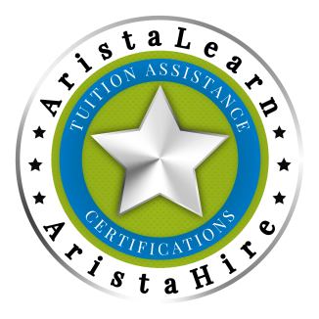
U.S. MILITARY CREDENTIALING ASSISTANCE PROGRAM
Certificate of Completion
Stephen Spinogatti
Administered by AristaLearn
Course Completion Date: April 27, 2025
This is to certify that
Has Successfully Completed this 35-Hour Course, earning 35 PDU Hours:
Lean Six Sigma Blackbelt| IASSC, ICCB
Robin L. Borough
Robin L. Borough, CEO, Co-Founder
Certificate Verification Code: LSSBB42725AL

Slide 2
U.S. MILITARY CREDENTIALING ASSISTANCE PROGRAM
Certificate of Completion
First Last Century Gothic 36
Administered by AristaLearn
Course Completion Date: Month, 00 XXXX Century Gothic 12
This is to certify that
Has Successfully Completed this Course:
Full Course Name Century Gothic 20
Robin L. Borough
Robin L. Borough, CEO, Co-Founder
Certificate Verification Code: Unique Code

Slide 3
U.S. MILITARY CREDENTIALING ASSISTANCE PROGRAM
Certificate of Completion
Administered by AristaLearn
Course Completion Date:
This is to certify that
Has Successfully Completed this Course:
Robin L. Borough
Robin L. Borough, CEO, Co-Founder
Certificate Verification Code:

